Slide 1
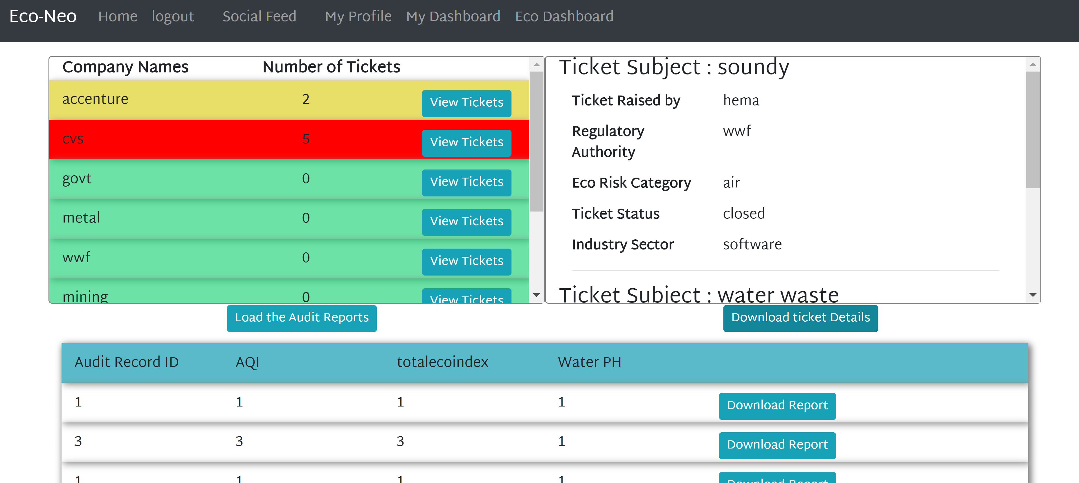
Eco-NEO
Eco Dashboard

Slide 2
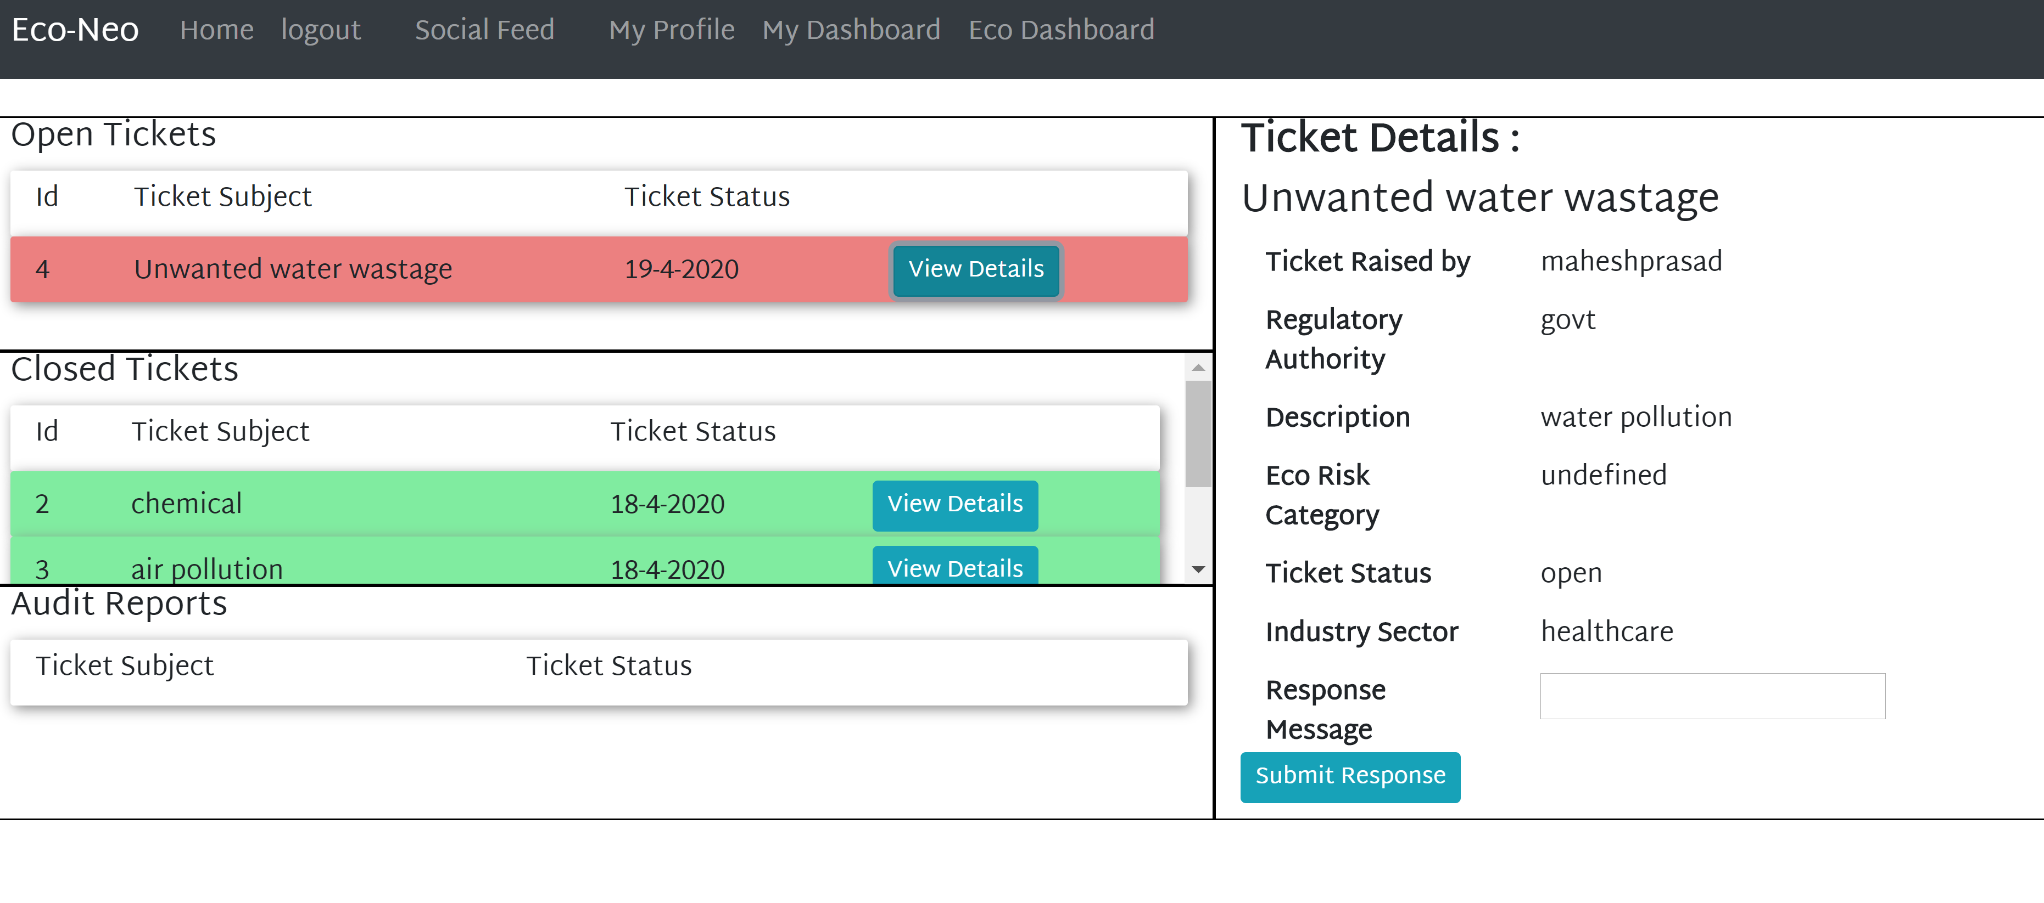
My DAShboard

Slide 3
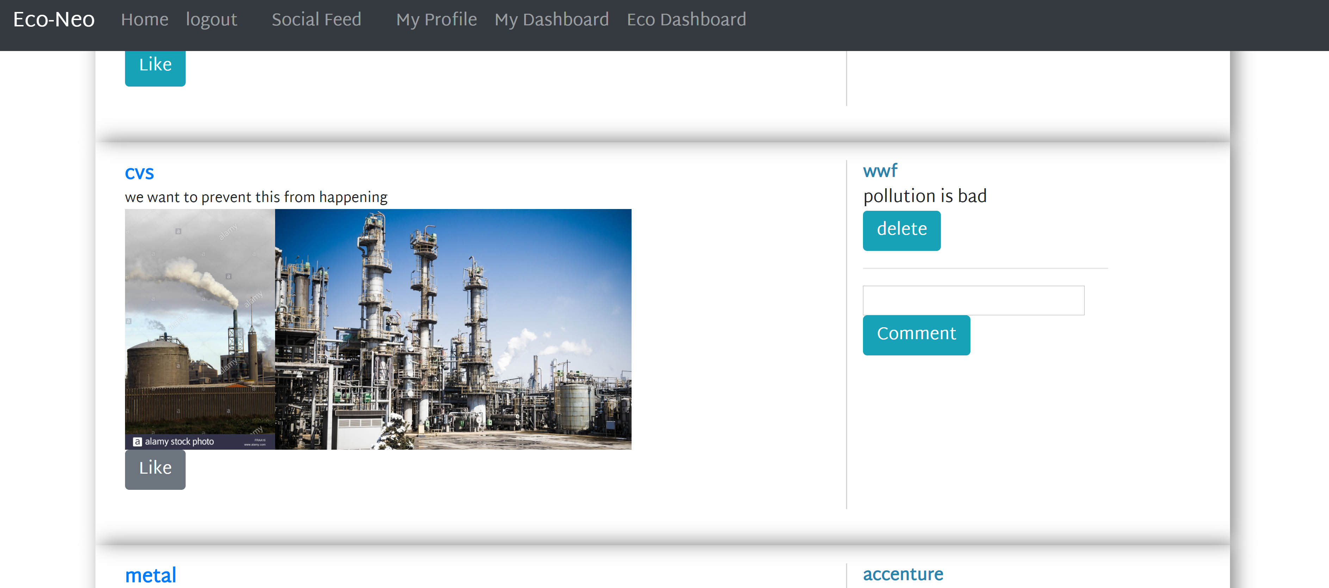
Social Feed

Slide 4
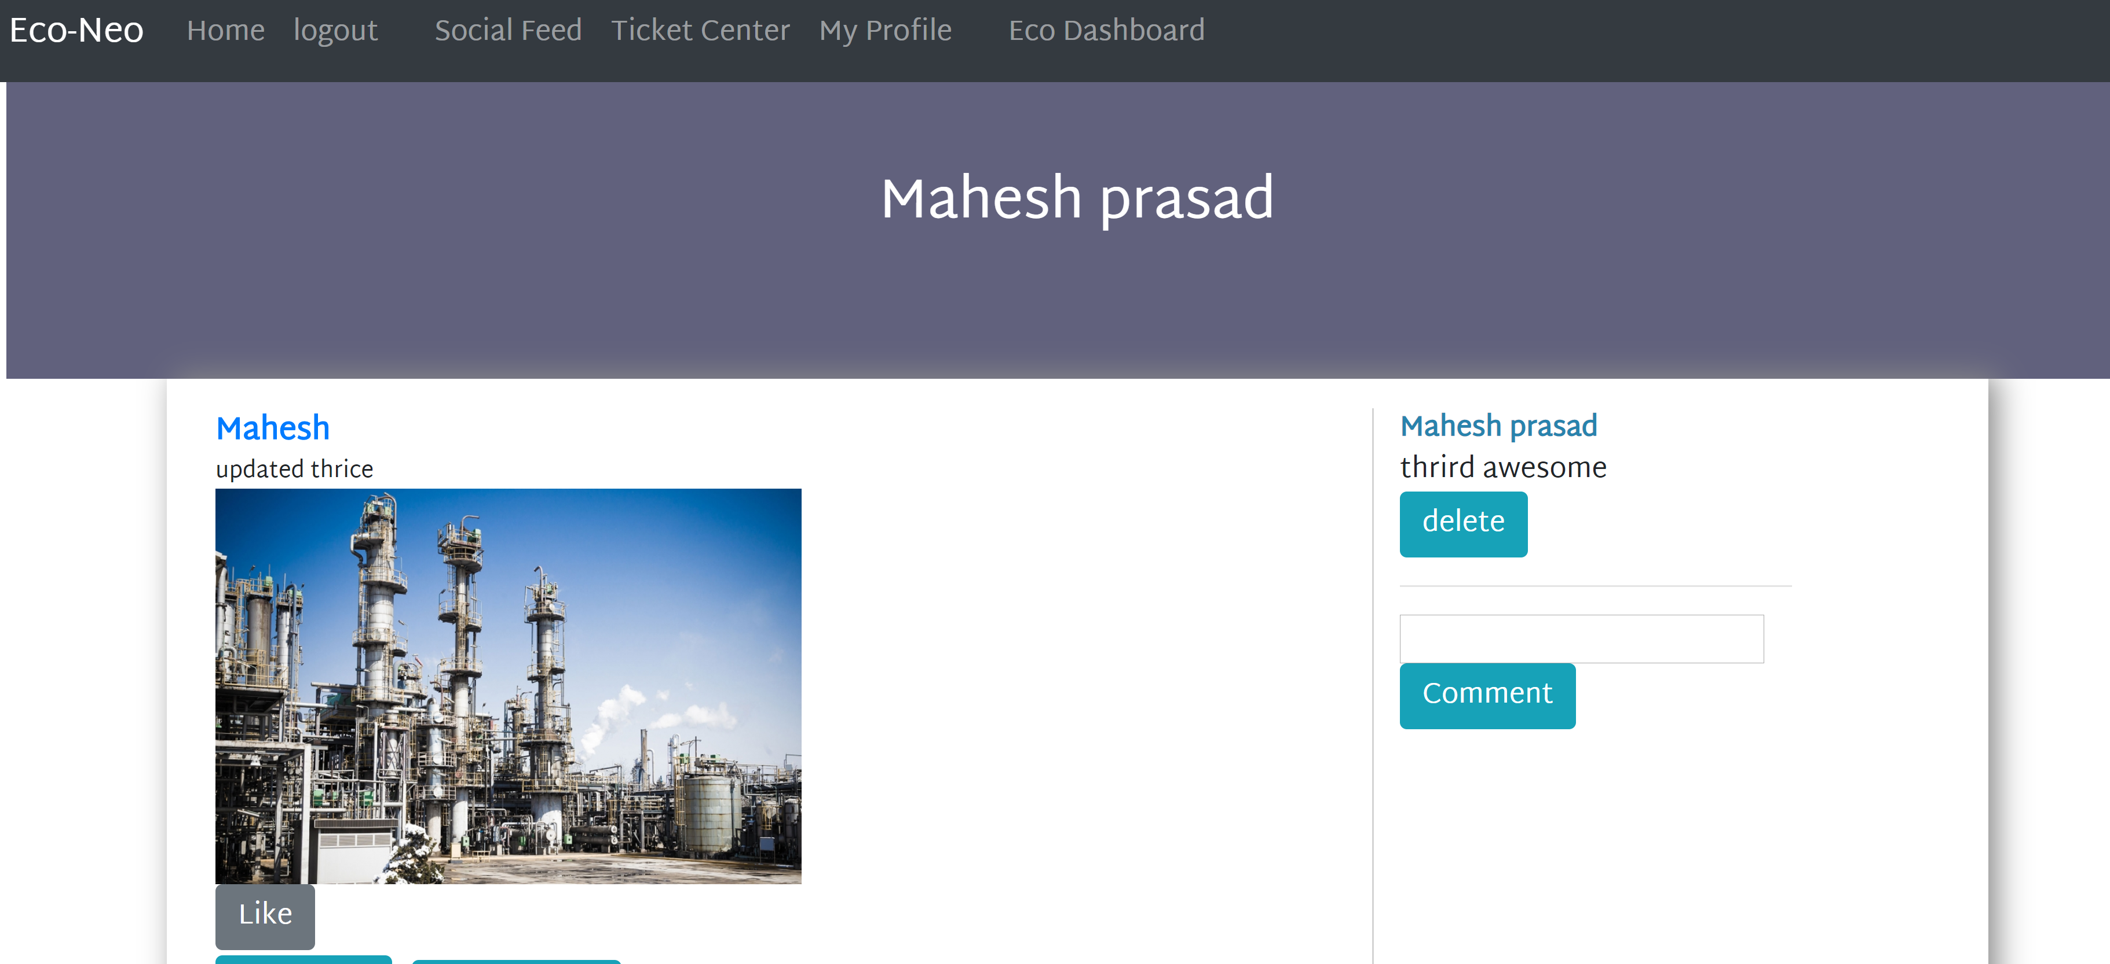
Profile Page

